Slide 1

stranger things
<south korea version>

Slide 2

sewol ferry disaster
1

Slide 3
1
6
2
0
1
4
april

Slide 4
443
325
33
2142
passengers
danwon students
crew
lbs cargo

Slide 5
294
10
dead
missing

Slide 6
causation
overloaded
cargo not properly secured
crew instruction
loudspeakers: "Please do not move from your location...Absolutely do not move." (8:52 am)
Jeju Vessel Traffic Services Center: "Please put on the life vests and get ready as people may have to abandon ship."
crew member: "It is hard for people to move."
captain abandoned ship
distress calls delayed (8:52 am)
port anchor conspiracy
human sacrifice

Slide 7
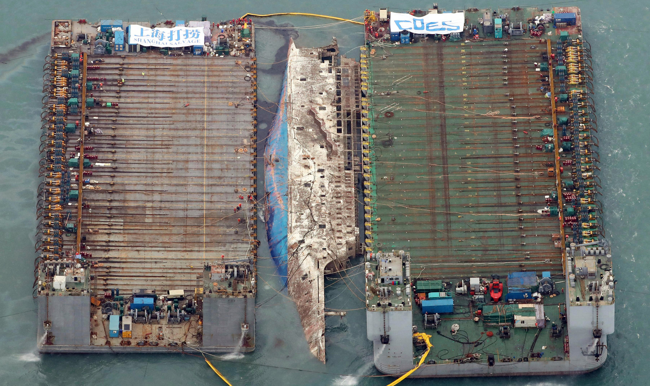
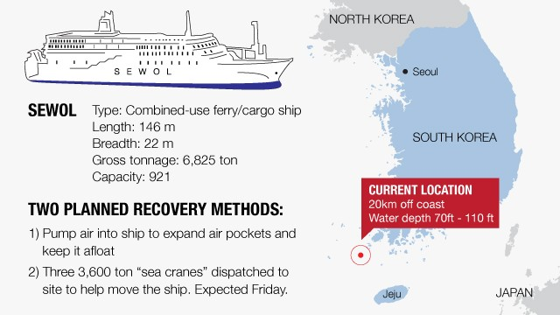
March-April 2017
$76 million
sewol ferry incident

Slide 8
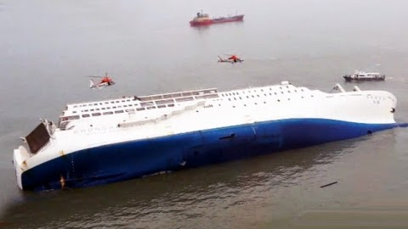
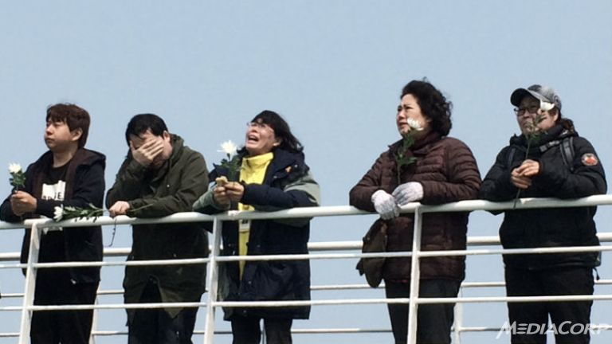

"Intention," directed by Kim Ji-young and produced by renowned journalist Kim Ou-joon

Slide 9








SEWOL IN K-POP

Slide 10
Passing by the edge of the cold winter, until the days of spring, until the flowers blossom, please stay, please stay there a little longer.
-BTS Jungkook, “Spring Day”

Slide 11
what does this mean?
“please stay, please stay there a little longer”
while the crew was abandoning the ship, they told the passengers to stay and wait
after the incident, the government told the families to stay put and wait

Slide 12
but wait,
there’s more

Slide 13
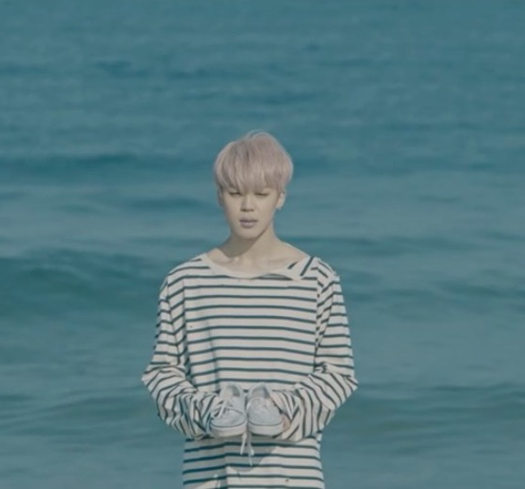
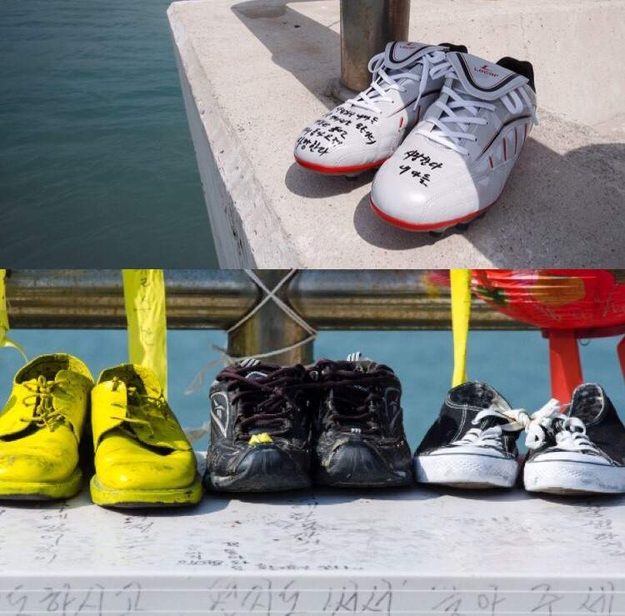
jimin in “spring day” music video
jimin is seen holding shoes in front of the ocean
families place shoes of lost ones along the shore with messages written on them

Slide 14
but wait,
there’s more

Slide 15
“Red Light” // f(x) - lyrics: “when everything sinks,” “warning,” “emergency exit”, “collision”
“The Light” // The Ark - plot: class of children die, released around anniversary
“One of These Nights” // Red Velvet - imagery: paper boats, Yeri (18) blurred on album, yellow butterfly (same color as Sewol Ferry ribbon), “AIS on 15-16” (Automatic Identification System turned off between April 15th & 16th), water, candles
“Come Back Home” // 2NE1 cover - performed 1 week after event in dedication to lost lives
“You Whom I Love” // Shin Yong Jae & Lee Da Won - composition on phone of victim (Lee Da Won) and finished by his role model Shin Yong Jae

Slide 16
hwaseong serial murders
2

Slide 17
1986-1991
september 15
april 3

Slide 18
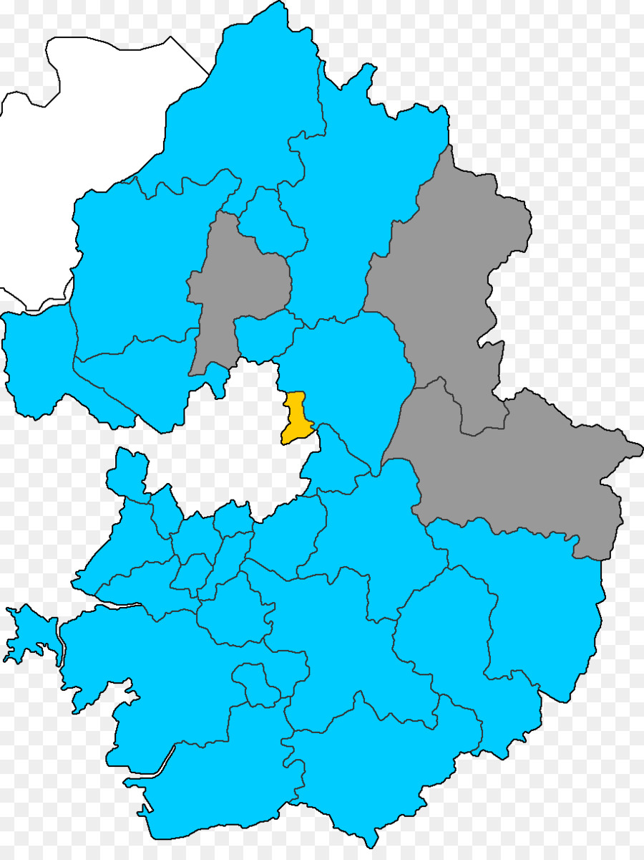

Slide 19

sept 15 ‘86
oct 20 ‘86
dec 12 ‘86
dec 14 ‘86
jan 10 ‘87
may 2 ‘87
sept 7 ‘88
sept 16 ‘88
nov 15 ‘90
april 3 ‘91
71
14
14
?
?
?

Slide 20
21,280
suspects

Slide 21


september 15, 1986 - april 3, 1991
20-30
165-170 cm
blood type: b

Slide 22
resurgence?
2004
college student
2006
karaoke hostess
2007
plastics bookkeeper

Slide 23
significance
first string of cases with modus operandi
april 2, 2006: statute of limitations expired (15 years)
july 2015: statute of limitations lifted
can revisit cold cases

Slide 24

american references
criminal minds

Slide 25
billy hargrove & mike carmichael
3

Slide 26
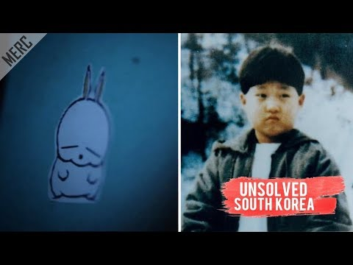
3:36 - 8:15

Slide 27
the end
or is it?

Slide 28
References
https://aminoapps.com/c/btsarmy/page/blog/theory-spring-day-sewol-and-omelas/r0wq_402feu05qkmvlNn21oMlYLjYzXonvW
https://www.allkpop.com/article/2016/03/theory-that-red-velvets-one-of-these-nights-is-a-tribute-to-the-sewol-incident-goes-viral
https://onehallyu.com/topic/314823-songs-dedicated-to-sewol/
https://www.koreaboo.com/lists/8-songs-commemorate-sewol-ferry-tragedy/
https://www.youtube.com/watch?v=WqDmPPWwmQY
https://en.wikipedia.org/wiki/Hwaseong_serial_murders
http://www.cnn.com/2014/05/15/world/asia/sewol-problems/index.html
https://www.cnn.com/2017/03/22/asia/south-korea-sewol-ferry/index.html
https://www.nytimes.com/2017/03/22/world/asia/south-korea-ferry-sewol.html
http://www.xinhuanet.com/english/2018-04/13/c_137108507.htm
http://www.atimes.com/article/new-documentary-rocks-boat-deadly-2014-ferry-sinking/

